Slide 1
Computer Programming Mid-term Test 2

Slide 2
Problem 5-6
How to read code?
Start from Main function
Code tracking

Slide 3
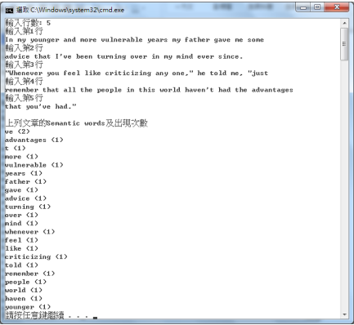
Problem 7
Expected Output
To summarize the question:
請寫一個程式，輸入文句，從中找出 semantic words，計算各 semantic word 出現次數，並將結果依出現次數，由高而低排序顯示於主控台螢幕
A bird in the hand is worth two in the bush

Slide 4
Problem 7
Expected Output
What function we need?
Handling user input <optional>
Split article into words.
Remove comma, period, etc.
Judge if a word is semantic words
Remove word from list if it is not semantic word
Sort semantic words by frequency
Print out
Given
InputArticle
ProcessLine
IsAStopWord

Slide 5
Problem 7
string[] name = new string[words.Length]; int[] freq = new int[words.Length]; int pointer = 0; // method 1 //count foreach (var str in words) { int response = inArray(str, name, pointer); if (response != -1) { freq[response] += 1; } else { name[pointer] = str; freq[pointer] = 1; pointer++; } } // bubble sort for (int i = 0; i < pointer; i++) { for (int j = i; j < pointer; j++) { if (freq[i] < freq[j]) { swap(ref freq[i], ref freq[j]); swap(ref name[i], ref name[j]); } } } // print for (int i = 0; i < pointer; i++) { Console.WriteLine("{0}: {1}", name[i], freq[i]); }
Intuitive

Slide 6
Problem 7
Improvement
Hash table
//method 2 SortedDictionary<string, int> hashtable = new SortedDictionary<string, int>(); foreach (var str in words) { if (hashtable.ContainsKey(str)) { hashtable[str] = hashtable[str] + 1; } else { hashtable.Add(str, 1); } } List<KeyValuePair<string, int>> list = hashtable.OrderByDescending(pair => pair.Value).ToList(); foreach (KeyValuePair<string, int> entry in list) { Console.WriteLine("{0}: {1}", entry.Key, entry.Value); }

